Slide 1
Redshift -ETL
Vikas

Slide 2
Introduction
Redshift is an enterprise-level, petabyte-scale, fully managed Datawarehouse service.
Datawarehouse is a data management system that is designated to enable and support business Intelligence activity, especially analytics.
Redshift supports all core functions of the Data warehouse. It’s scalable, performant, cost-effective, easy to manage, ML optimized, and Integrated with 3’rd part tools and various AWS services. It’s SQL ready.
Notes:
STAR schema has fact and dimensions tables. Facts tables contain events and observations that can be measured. eg Sales & Listing
Dimension tables provide information on business entity 5 in our example.
OLTP – Operational & transactional data stored in a relational DB
continuously changing
OLAP – Subject & analysis. Stored in star, snowflake, or fact constellation models.
historic or static data

Slide 3
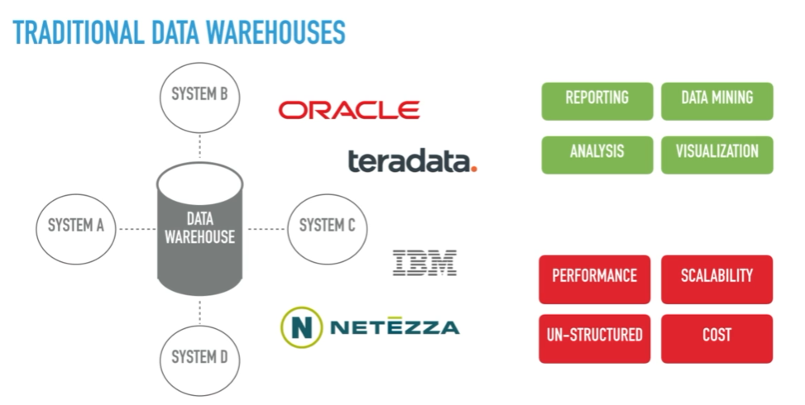

Slide 4
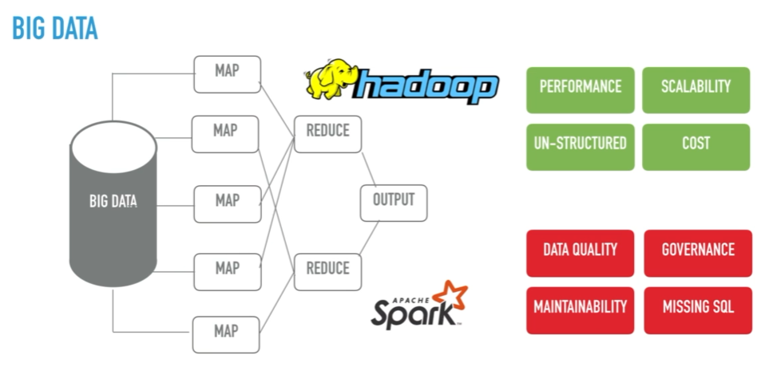

Slide 5
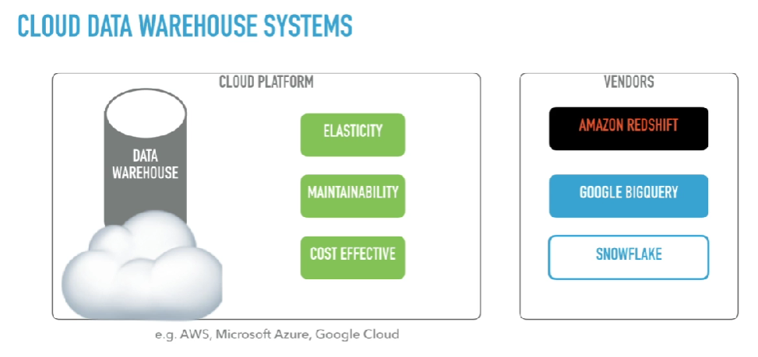
Notes:
NOSQL DB:
========
Document - MongoDB
Key-Value - Redis
Graph – neo4j
Columnar - Redshift

Slide 6
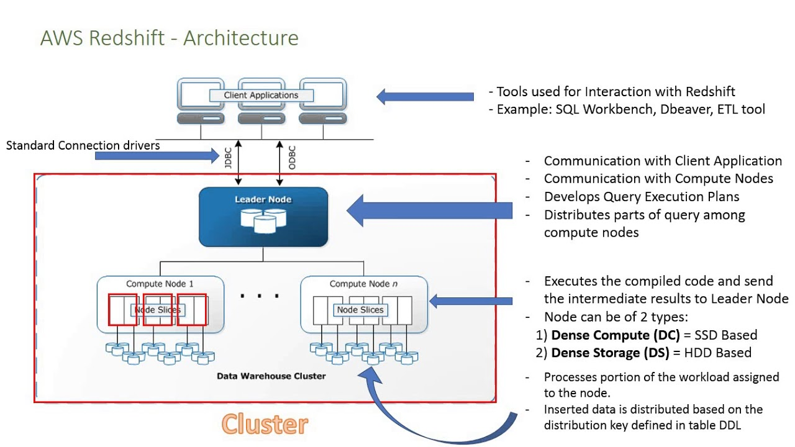
Notes:
https://docs.aws.amazon.com/redshift/latest/gsg/rs-gsg-create-sample-db.html

